Slide 1

Amy Richardson & Dr. Peter Antevy

Slide 2
CODE GOALS
Promote Closure for Family
1
Prioritize Family as a Patient
2
Give Time to Say Goodbye
3
Facilitate Healthy Grief
4

Slide 3
PEARLS
Create a Positive Connection
Communication
Direct Communication
Gentle Delivery
Eye Level
Physical Communication
Emotional Communication
Utilize Empathy and Compassion

Slide 4
FIGHT
FLIGHT
FREEZE
Fight/Flight
Catecholamine dump. Can be expressed as a mix of emotions.
Freeze AKA Dissociation
The Parasympathetic response to the Fight/Flight activation.
“This doesn’t feel real.”
“This feels like a dream.”
“I feel numb.”
“This isn’t happening.”
Slowed speech, movement, flat affect, and appear to not be reacting “normally”.
High levels of dopamine, serotonin, GABA activation, etc.
You may see hyperventilating, incontrollable sobbing, inability to follow direction, rocking, etc.

Slide 5
WORKING THE CODE ON SCENE
Minimizes interruptions of CPR, BLS, and ACLS care
Better Patient Outcomes
Provides the opportunity for family to be present with the child
Gives family more time to say goodbye

Slide 6
CAREGIVER INVOLVEMENT
Assign
Assign a provider to be with them and explain what we are doing and why.
Allow
Allow them to hold the hands or feet of the patient, so long as they are directable.
Call
Offer to call someone to come be with them.
Explain
Tell them we are circulating their blood and breathing for them and they can talk to them.

Slide 7

TRANSPORT
Inform the caregiver if/when you will be transporting
Allow the primary to ride up front
Allow other family to be tx by friends or by other apparatus if allowed
Same provider remain with the family until the patient is settled into the ER.
If still coding the patient, remain with the caregiver until TOD is declared or a few minutes after ROSC is gained.
  This allows for better care for the family members and an easier transition for ER staff who will have to take over caring for the family.

Slide 8
CALLING THE CODE
Before stopping CPR offer 2 minutes for family to say goodbye.
Honor their wishes, either way. Everyone reacts differently to trauma and has different needs.
Once ready to stop CPR, state you are now are going to stop compressions THEN stop them.
Allow the brain a moment to prepare for cessation

Slide 9
CALLING THE CODE
Check for pulse, heart tones, electrical activity.
Direct Empathetic Communication
Same provider should remain with the caregivers and provide comfort.
Find ways to provide physical comfort

Slide 10
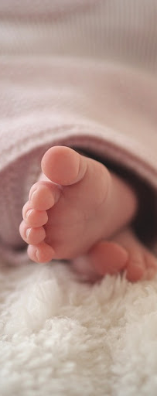
SMALL CHILD PREPARATION
Clean up the body
Position the patient very naturally so they appear to be sleeping as much as possible.
Wrap in a blanket with arms and feet out to be held/touched.
Close eyes if possible
Place in arms of seated caregiver(s)
Remain in direct line of sight of the caregiver/child

Slide 11
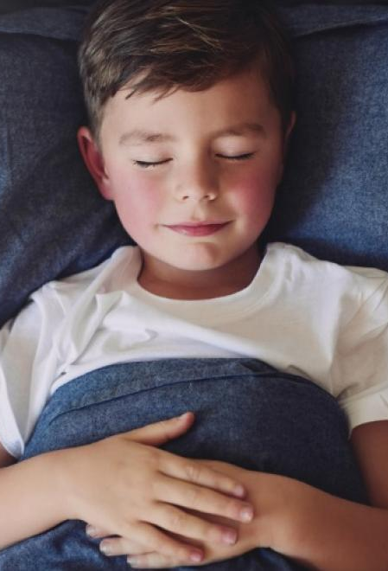
LARGE CHILD PREPARATION
Cross ankles
Thick blanket up to the armpits
Both arms/hands over the blanket, at over the ABD
Pillow or towel roll under the neck for more natural positioning
Cross the ankles
Close eyes if possible

Slide 12
POST-DEATH CARE
Take a few minutes and clean something
Make them coffee and food if they want it. Ask if they have eaten, are they diabetic?
Do not afraid to hold them or cry with them.
Some people see grief as BELONGING to the family only, and believe it selfish to allow yourself to grieve as well
This is profoundly detrimental to the provider and the family
  We SHARE the burden of their grief.
  Increased risk of mental health problems to provider
  Learn how you best process emotions/calls

Slide 13

FOLLOW-UP
Try to follow up with the caregivers within a week or two.
Family will have a lot of questions during this time and this provides them with better closure.
Caregivers may have memory gaps and ask questions previously answered. This is a normal response to trauma.

